Slide 1

3rd Semester Mini Project
Session : 2021 - 22
Canteen Management System
Made By : Mohit Singh Dhami

Slide 2
Features of Canteen Management System
Buy Items : We can Select Variety of Items from The Canteen Items Menu and Proceed to Buy Them.
Coupons Code : We can Grab 10–50 % Discount on Items by Applying Valid Coupon Code at Checkout step.
Bill Generation : We can Generate Bill After Buying From The Canteen with Proper Details such Name , Time-of-Purchase and Total Amount to be Paid
Edit Item Menu: We Allow Admin of The Canteen To Fully Customize (Insert, Delete and Replace Items ) in his Canteen Menu.
Check Overall Sales: We Allow Admin to Check all the Sales he Made and Total Revenue they Have Collected From Customers
Database: We Have used file salesdata.dat as database to Store User Details Such Name, Spendings and Time-of-Purchase.

Slide 3
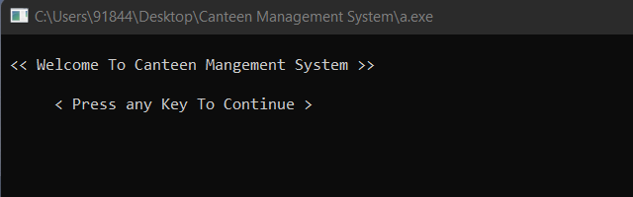
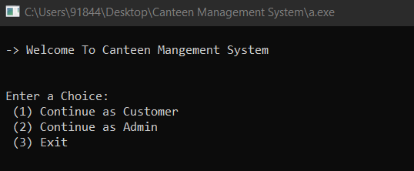
Project Explanation
When We Start our Application we can see a Welcome Page.
After Pressing any Key, We get a User Selection Page where we can Select Customer and Admin as a user or Press 3 to Exit From Program.

Slide 4
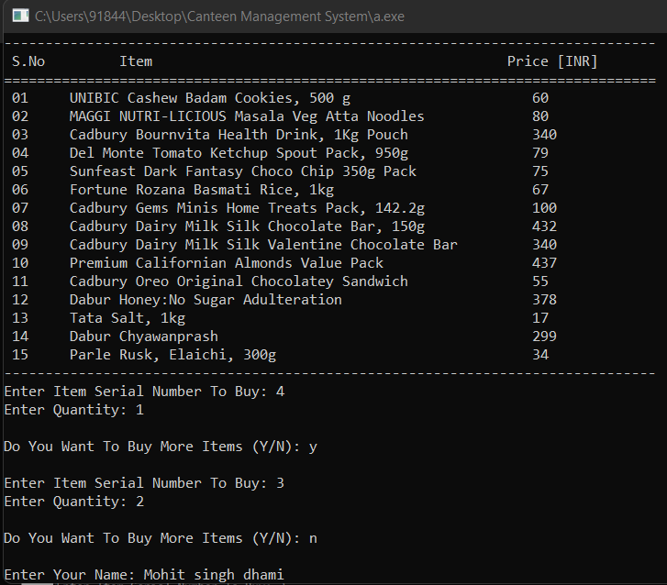
Project Explanation ( Continue as Customer )
When We Enter into the Customers Page, we can see the Variety of Food Related Items in the Canteen Menu
We have To Provide Serial Number Followed by Quantity to Add Items to Buying List
After Purchasing, We Have to Enter our Name at the End.
After Hitting Enter we are Send to Checkout Page.

Slide 5
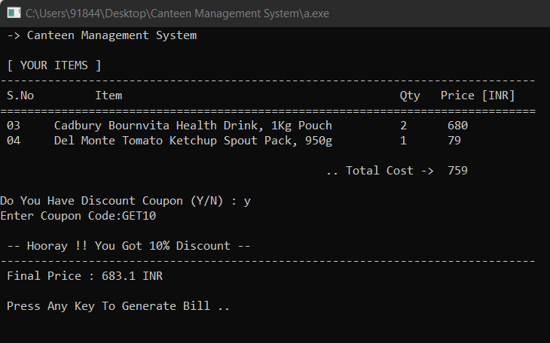
Project Explanation ( Continue as Customer/ Checkout Page )
Output With Correct Coupon Code
In The Checkout Page we can Summarize our Buying List and Check our Total Cost for Purchase
Here Customers is also asked if he has Discount Coupon or not. If He Says ‘ Y ‘ , He has to Enter a Code Which is Then Checked in the System and the Decision is taken Accordingly.
If The User Fails to Enter Correct Coupon Code, we ask for Retry and same step is Followed again and again

Slide 6
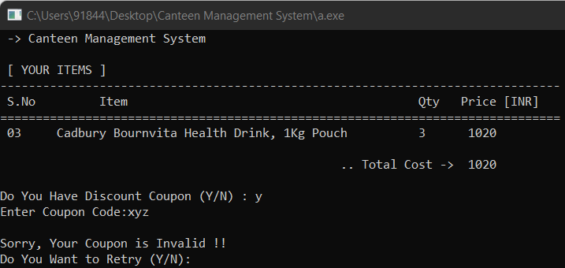
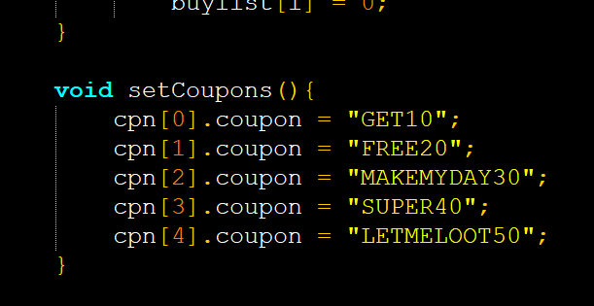
Project Explanation ( Continue as Customer/ Checkout Page )
Output With incorrect Coupon Code
All Coupons Code Set in Application – Source Code

Slide 7
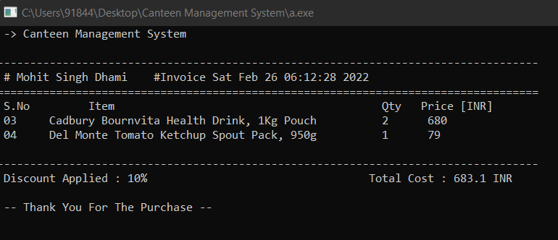
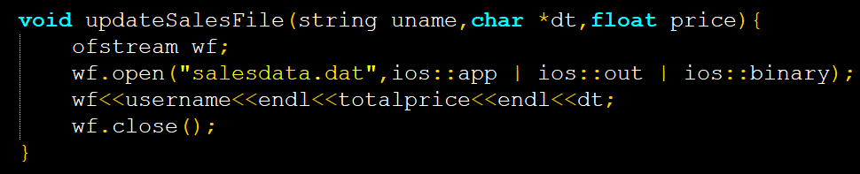
Project Explanation ( Continue as Customer/ Invoice Page )
Now we are in The Invoice Page, Where User can see Customer name on the Top Followed by Billing Date.
All The Items Selected for Buying can be seen Clearly in the List.
At the end Discount Applied and Total Purchase Cost is Written.
All The User Details is Saved to salesdata.dat File at the End

Slide 8
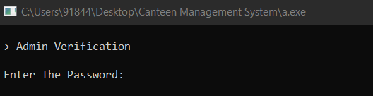
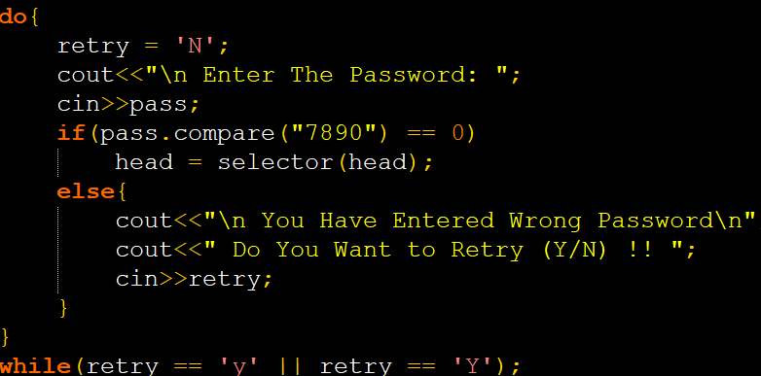
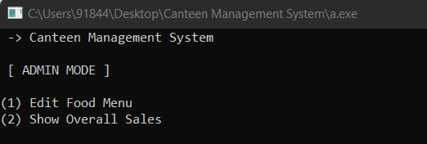
Project Explanation ( Continue as Admin )
To Continue as Admin, Firstly we Request user to Enter Verification Password
After Successful Verification We are Finally at the Admin Page, Where we have Two Options :
1. Edit Food Menu – We can Customize the Canteen Food Menu as Per Our Choice with Different Methods
2. Show Overall Sales – If The Admin Requires Details of all Customers with their Spendings He / She can Easily Track all His Sales Data with the help of this Functionality.
Code for Admin Verification
Options for Admin Mode

Slide 9
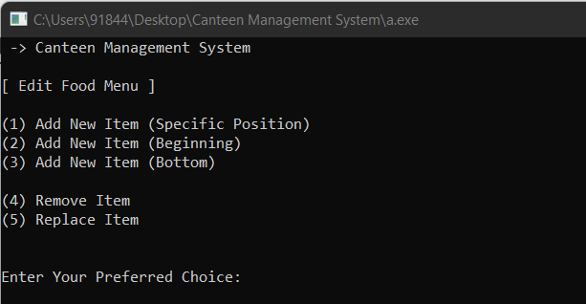
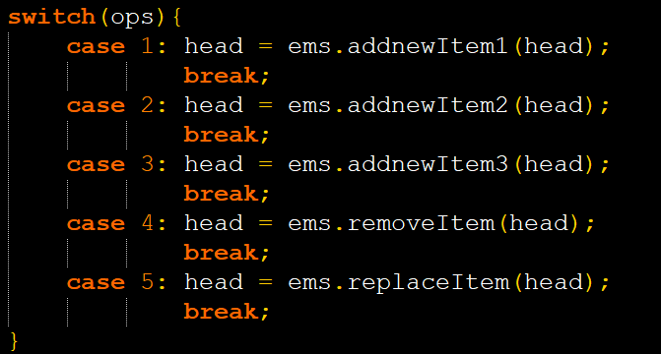
Project Explanation ( Continue as Admin / Edit Food Menu )
In Edit Food Menu Page we have 5 Options :
1. Add New Item (Specific Position) – We have to Enter Item Name, Price and the Location Where it needs to be Set in Items Menu ( Customers Page )
2. Add New Item (Beginning) – We Can Add Items at the Beginning of the Items Menu (Customers Page)
3. Add New Item (Bottom) – We Can Add Items at the Bottom of the Items Menu (Customers Page)
4. Remove Item – This Simply Removes the Items from The Item Menu By Entering Its Correct Serial Number
5. Replace Item – This Option Replaces the Item of Item Menu with New Name and Price
Code to Call all The above Methods

Slide 10
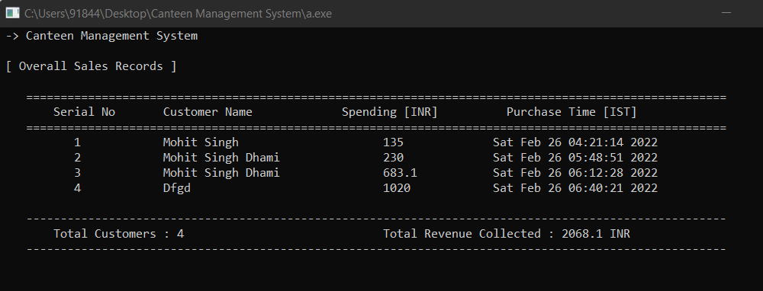
Project Explanation ( Continue as Admin / Show Overall Sales )
Displaying Sales Record from salesdata.dat File
In This Page, Admin can Clearly See all his Customers Information Such as Name, Spendings and Purchase Time.
At Bottom, We also Provide Facility to Check Total Customers and Total Revenue Collected by Canteen.

Slide 11
Thank You

